Slide 2
Tech:
IT
Advanced App Dev

Slide 3
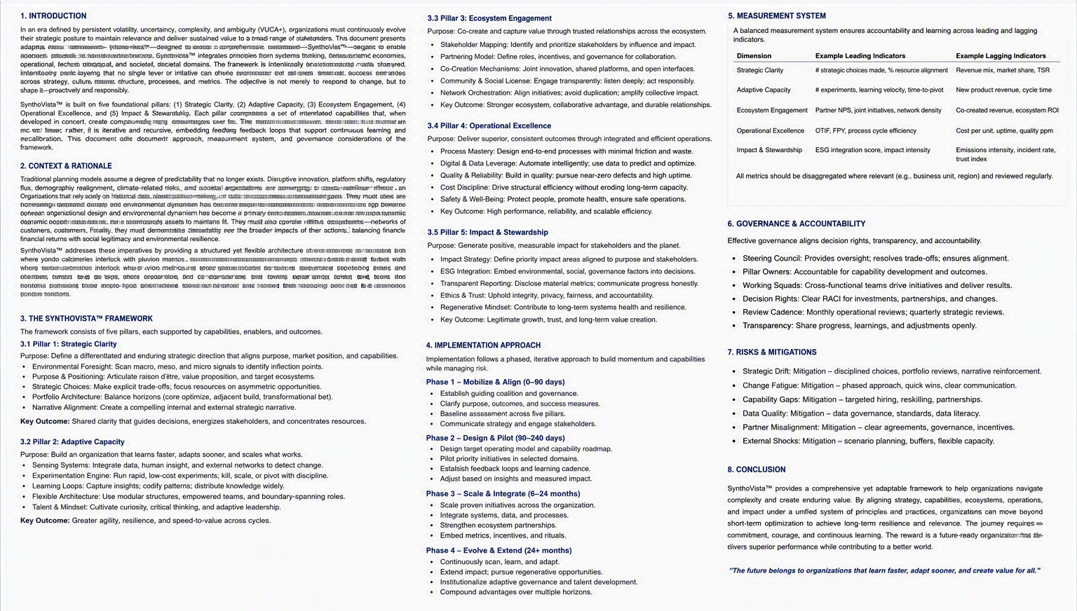
Core: Self Managment
So, I learned a good amount in self-management

Slide 4
Favorite Memory

Slide 5
Club:
Art Through The Ages
Star Trek Club

Slide 6
Of course,

